Slide 1
ESG Client round table & lunch
2nd September 2024
Notes:
Front cover images included in separate folder

Slide 2
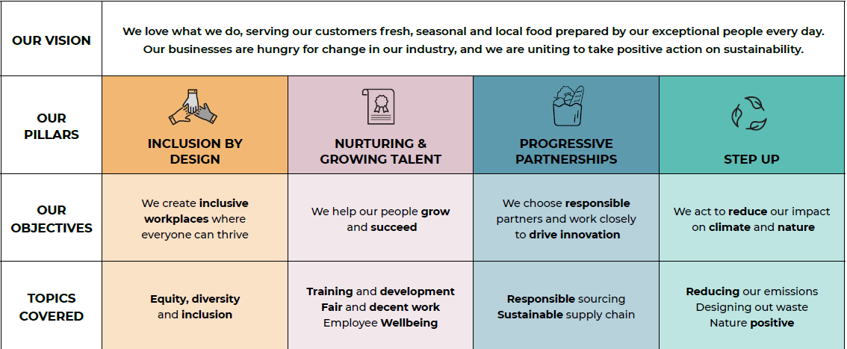
Second Nature ESG strategy
Notes:
This page can be changed to a different amount of photos using the ‘new slide’ (see next slide)

Slide 3
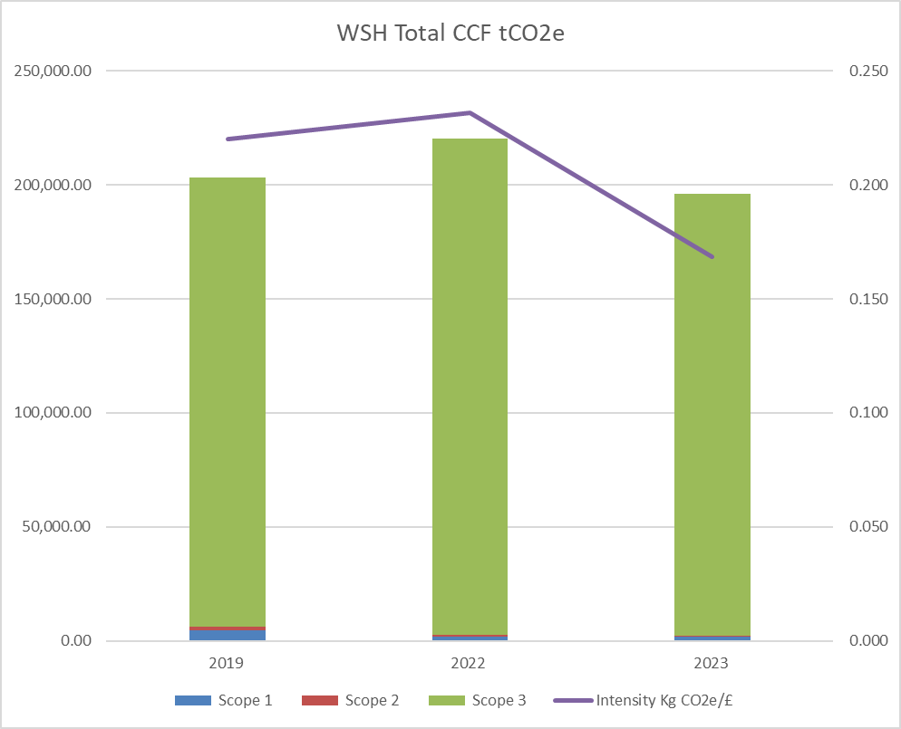
SBTi approval & 2023 progress
Progress was strong towards our emissions reduction targets.
Significant and ongoing improvements in data quality and emissions mapping accounts for some of the reductions.
Total scope 3 inventory has reduced in terms of GHG emissions for £ of value added (GEVA) by -21.95%. Scope 3 makes up almost 99% of our total footprint.
Excellent early progress towards our targets and a positive start to our net zero journey.
Notes:
Speechbubbles are editable and can be moved, deleted or resized

Slide 4
Carbon footprints, budgets & reporting
March 2024 near term, net zero and FLAG targets approved by the Science Based Targets Initiative (SBTi).
Absolute reduction of our total footprint across our UK & Ireland businesses of -3.6% against our 2019 baseline.
Stakeholder engagement - supplier workshops, ZCF, Groundswell, Arena, CEDA.
Second Nature first annual report published.
Notes:
This page can be changed to a different amount of photos using the ‘new slide’ (see next slide)

Slide 5
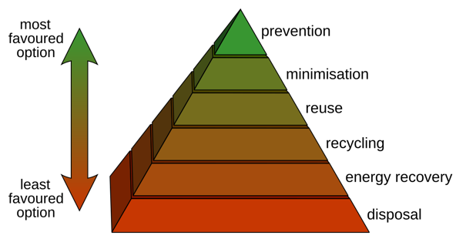
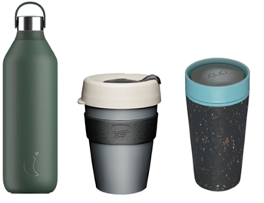
Waste & circularity
Aligned to available waste streams.
Follow the waste hierarchy.
Swapping one single use material for another is largely futile.
Reusables are way forward.
Waste reduction – cost, disposal.
Horses for courses!
Extended producer responsibility (EPR).
Notes:
This page can be changed to a different amount of photos using the ‘new slide’ (see next slide)

Slide 6
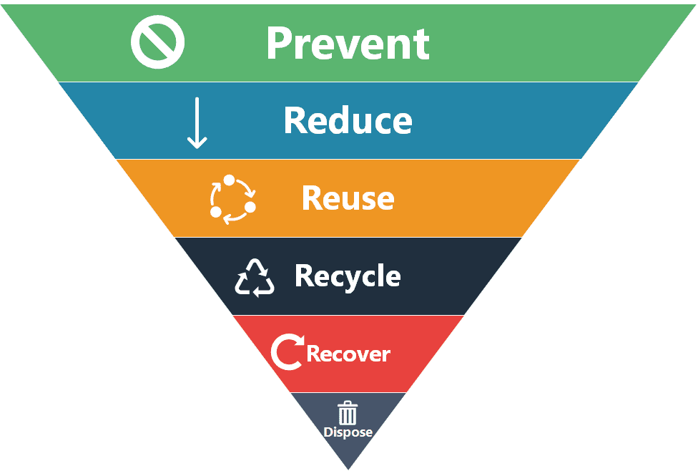
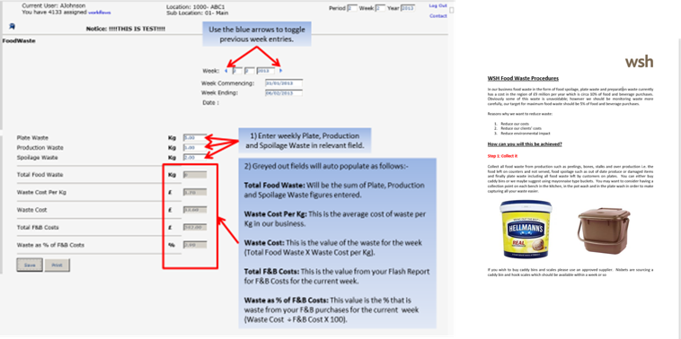
Food waste
BM have reduced food waste by 16% this year.
Saving food cost, disposal cost, energy cost and 3.39kg CO²e per kilo of food waste!
Notes:
This page can be changed to a different amount of photos using the ‘new slide’ (see next slide)

